Slide 1
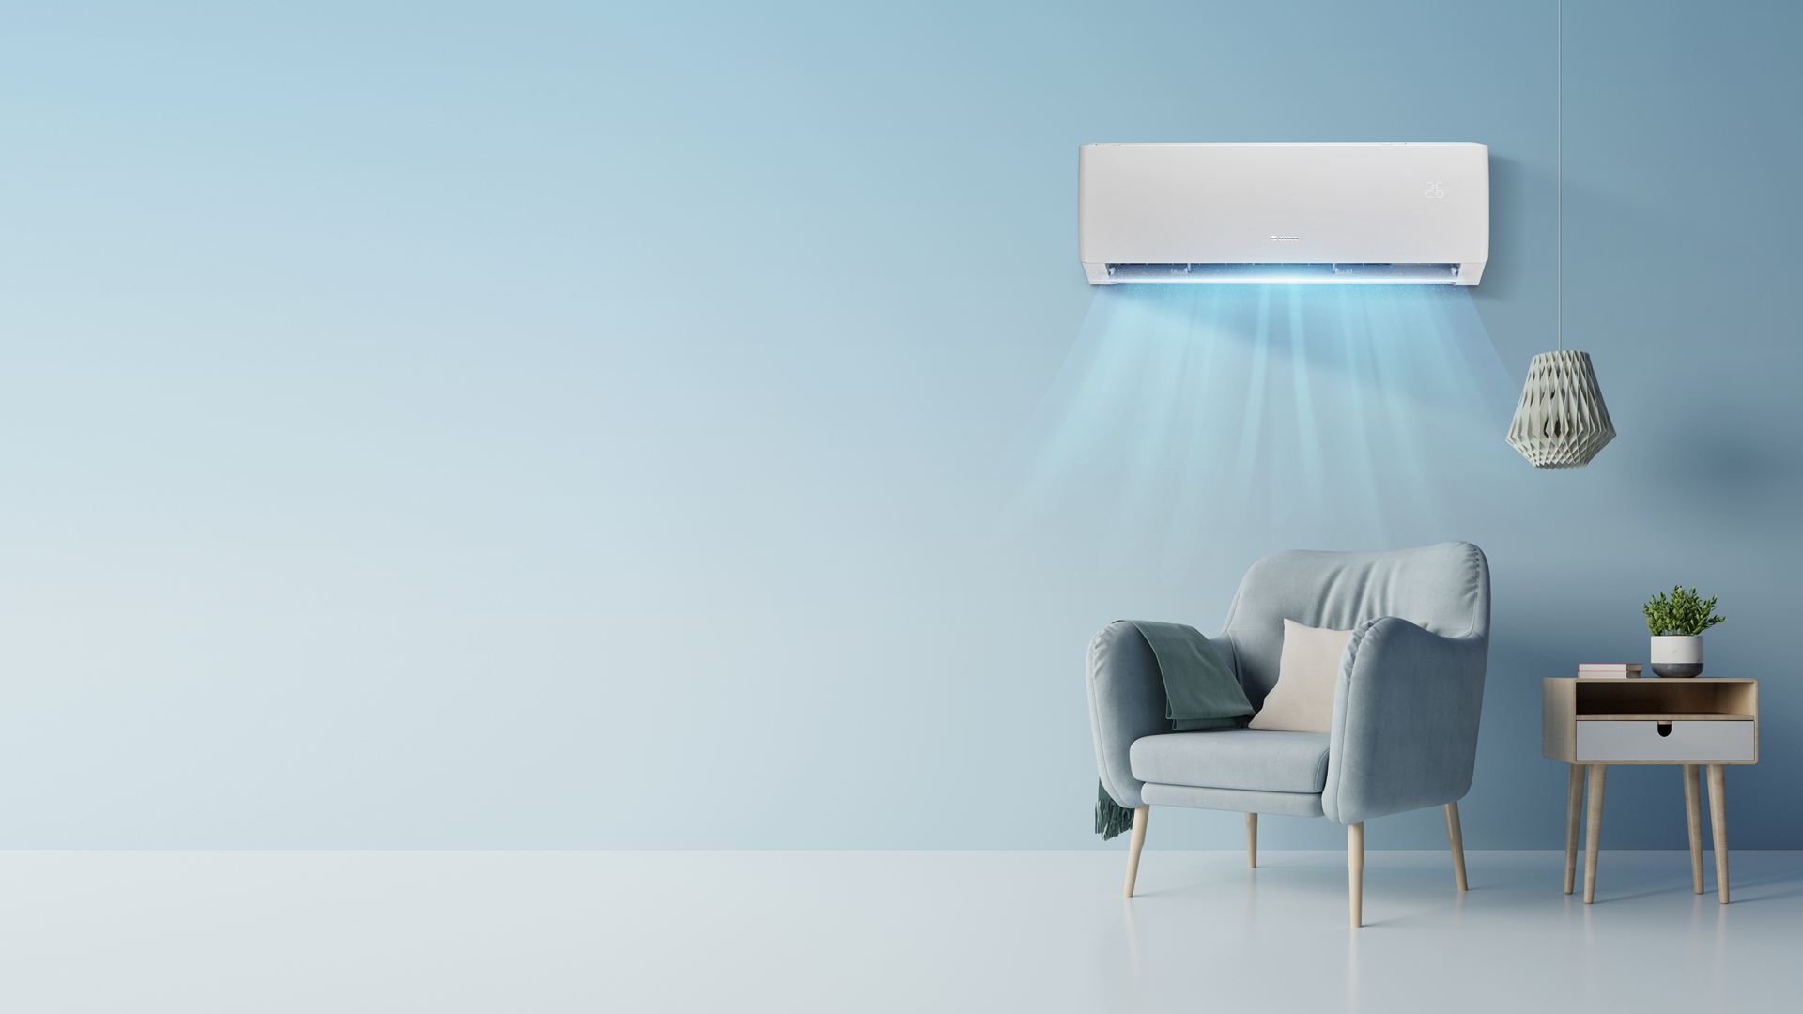

Wi-Fi connection for wall, compact floor and floor standing units

Slide 2
The following is a guide to connection of the high wall, compact floor console and floor standing units to the Gree+ App.
Ensure your router can connect to 2.4ghz as heat pumps of all brands
Download the latest version of the Gree+ App from Play Store or App Store.
Sign up and allow prompts you are asked about and allow updates if required. The App now has a New Zealand location instead of Australasia
There are 3 devices trying to connect together. There is a list of potential things to look at if the app does not connect. If you see the module through the device, it could be the router side not doing the final connection. You may need to talk to your service provider to ensure it can allow the unit to connect.

Slide 3
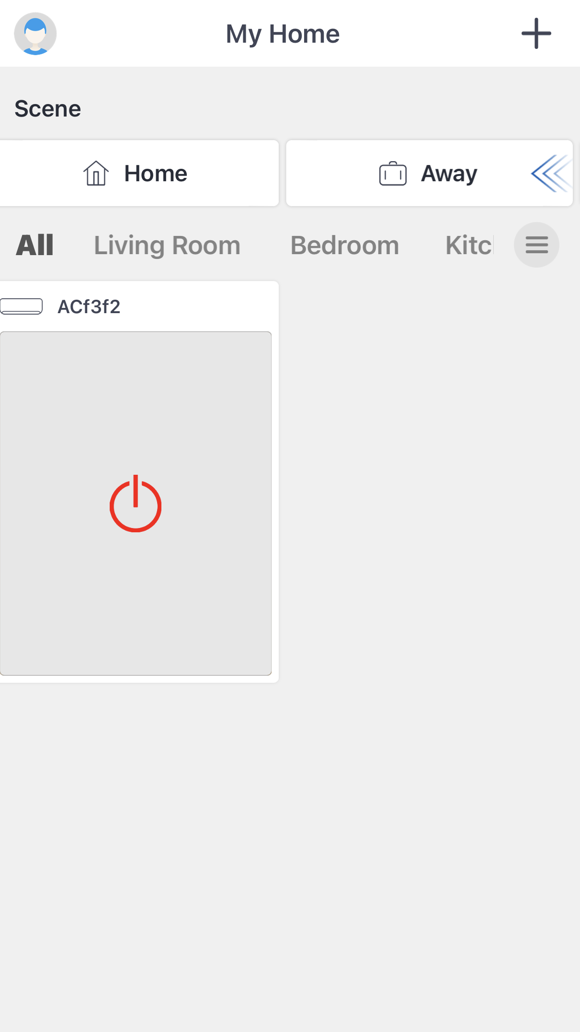
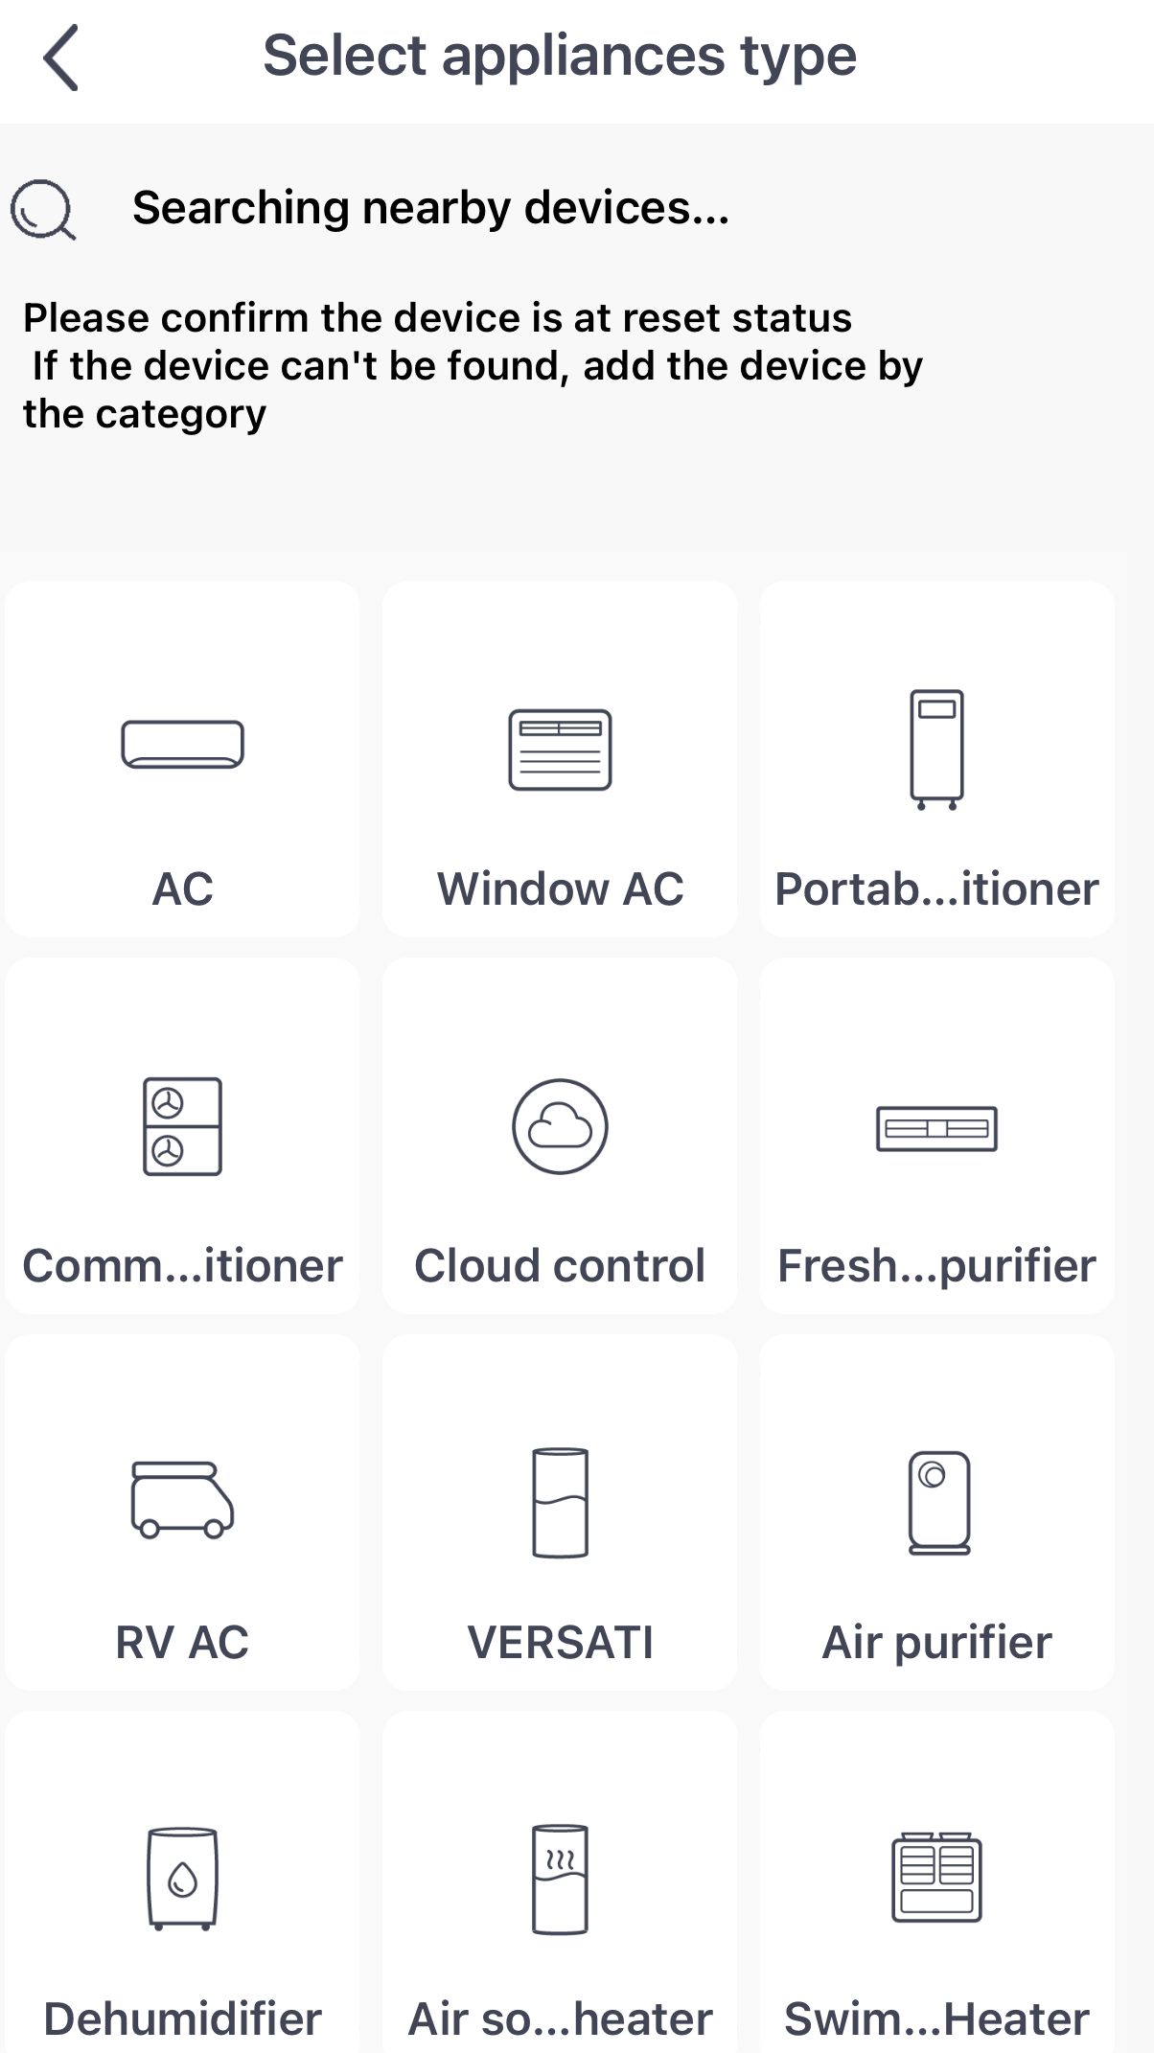
Click to add unit
Click AC

Slide 4
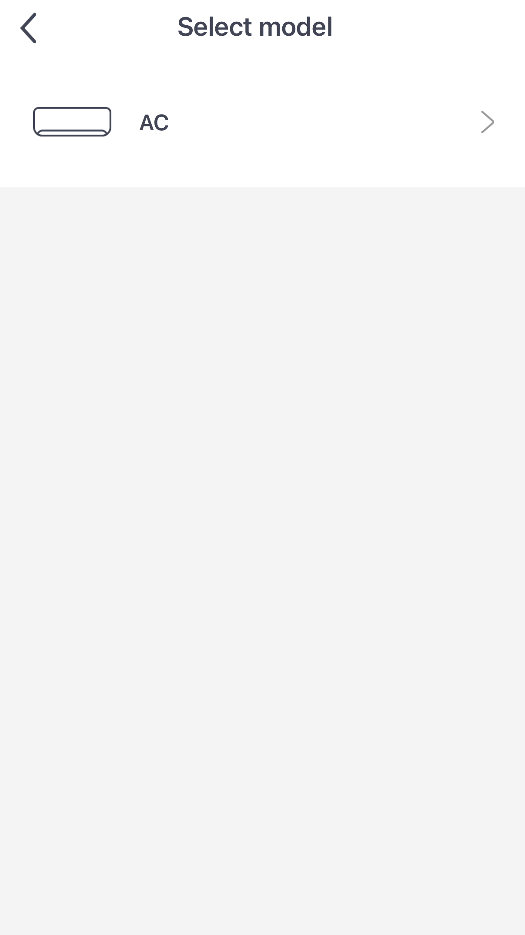
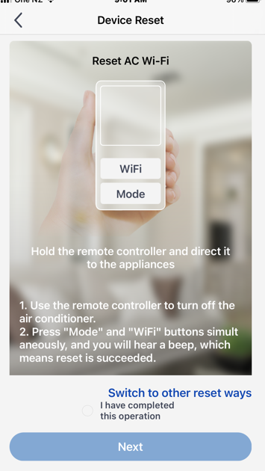
Click AC
Follow the reset instructions, unit should be off when connecting and then highlight the small circle after completing reset

Slide 5
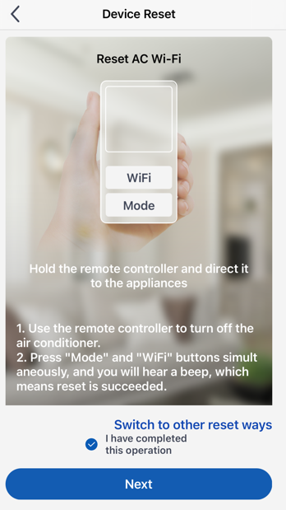
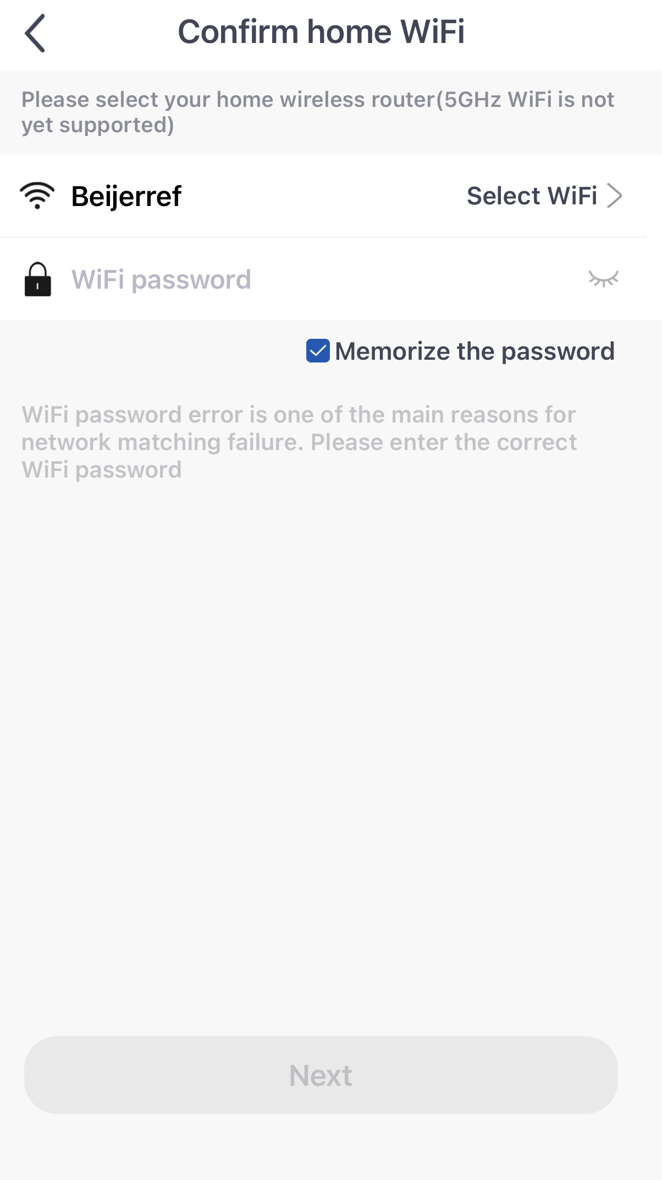
After clicking Next, choose your home 2.4ghz Wi-Fi and put in home Wi-Fi password. Heat pumps currently only use 2.4ghz and will not connect to 5ghz

Slide 6
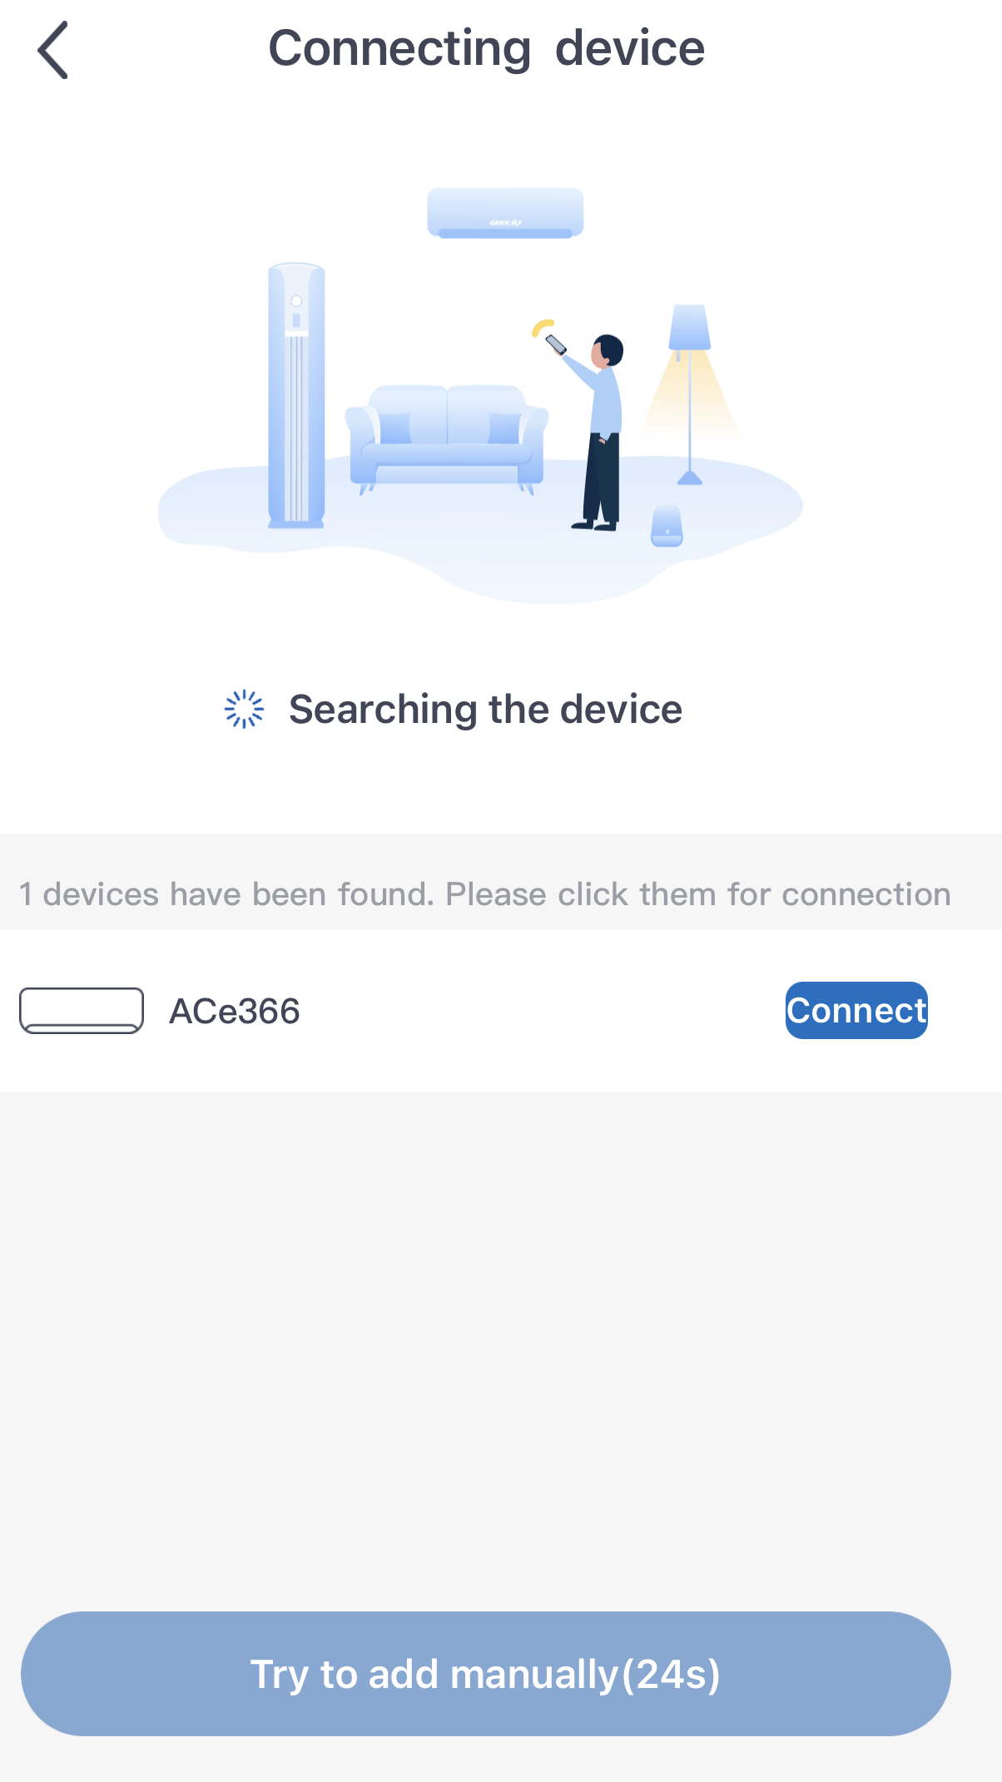
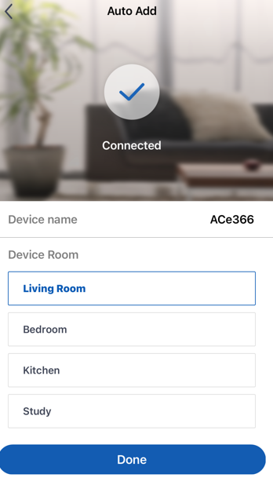
Unit should be picked up, press connect
Click Done after connected and if you have selected what the room is

Slide 7
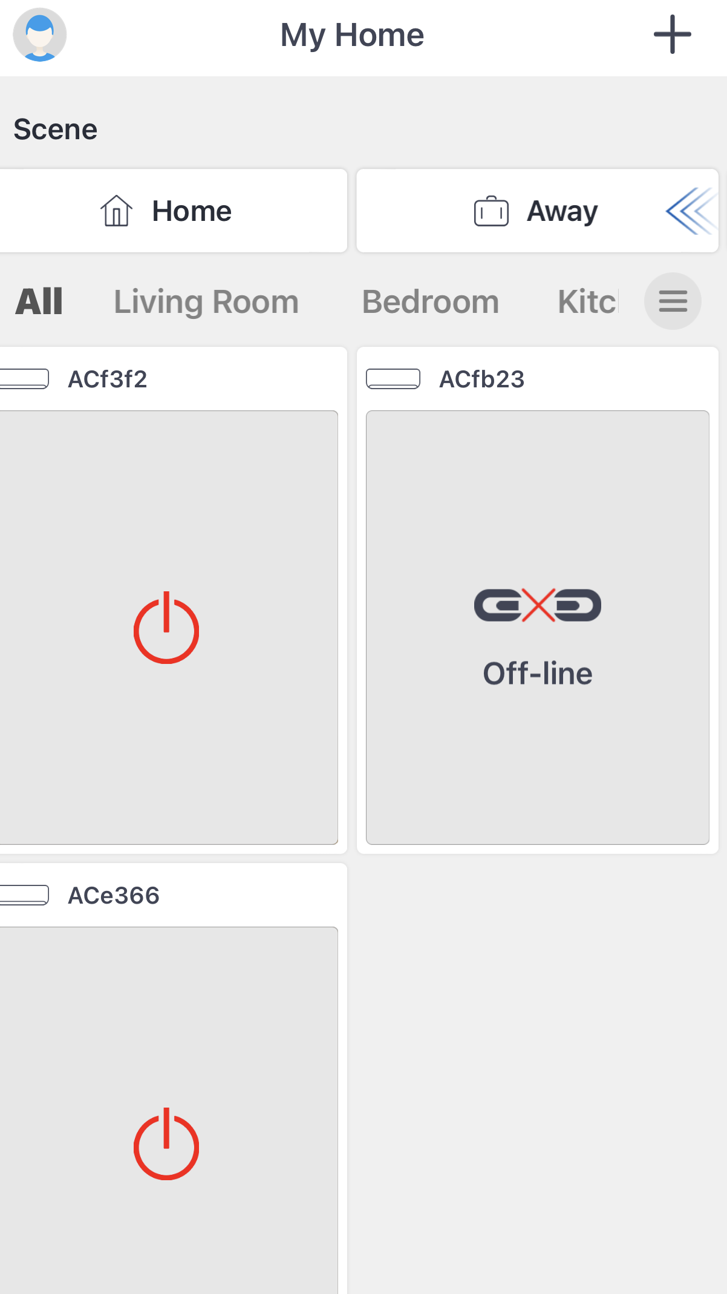
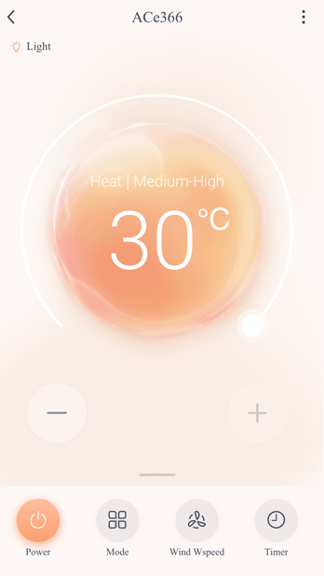
Your unit should now show up on the App and is ready to switch unit on

Slide 8
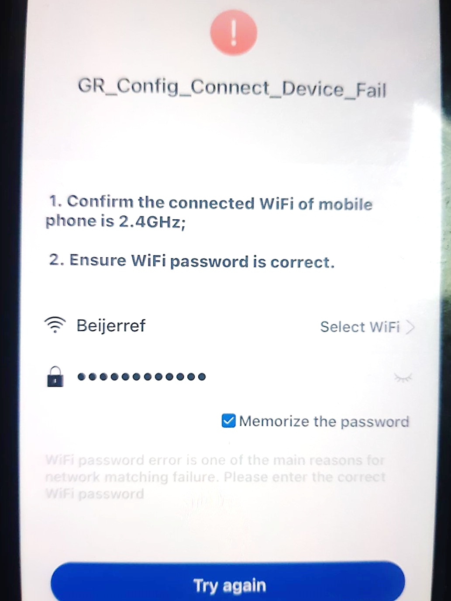
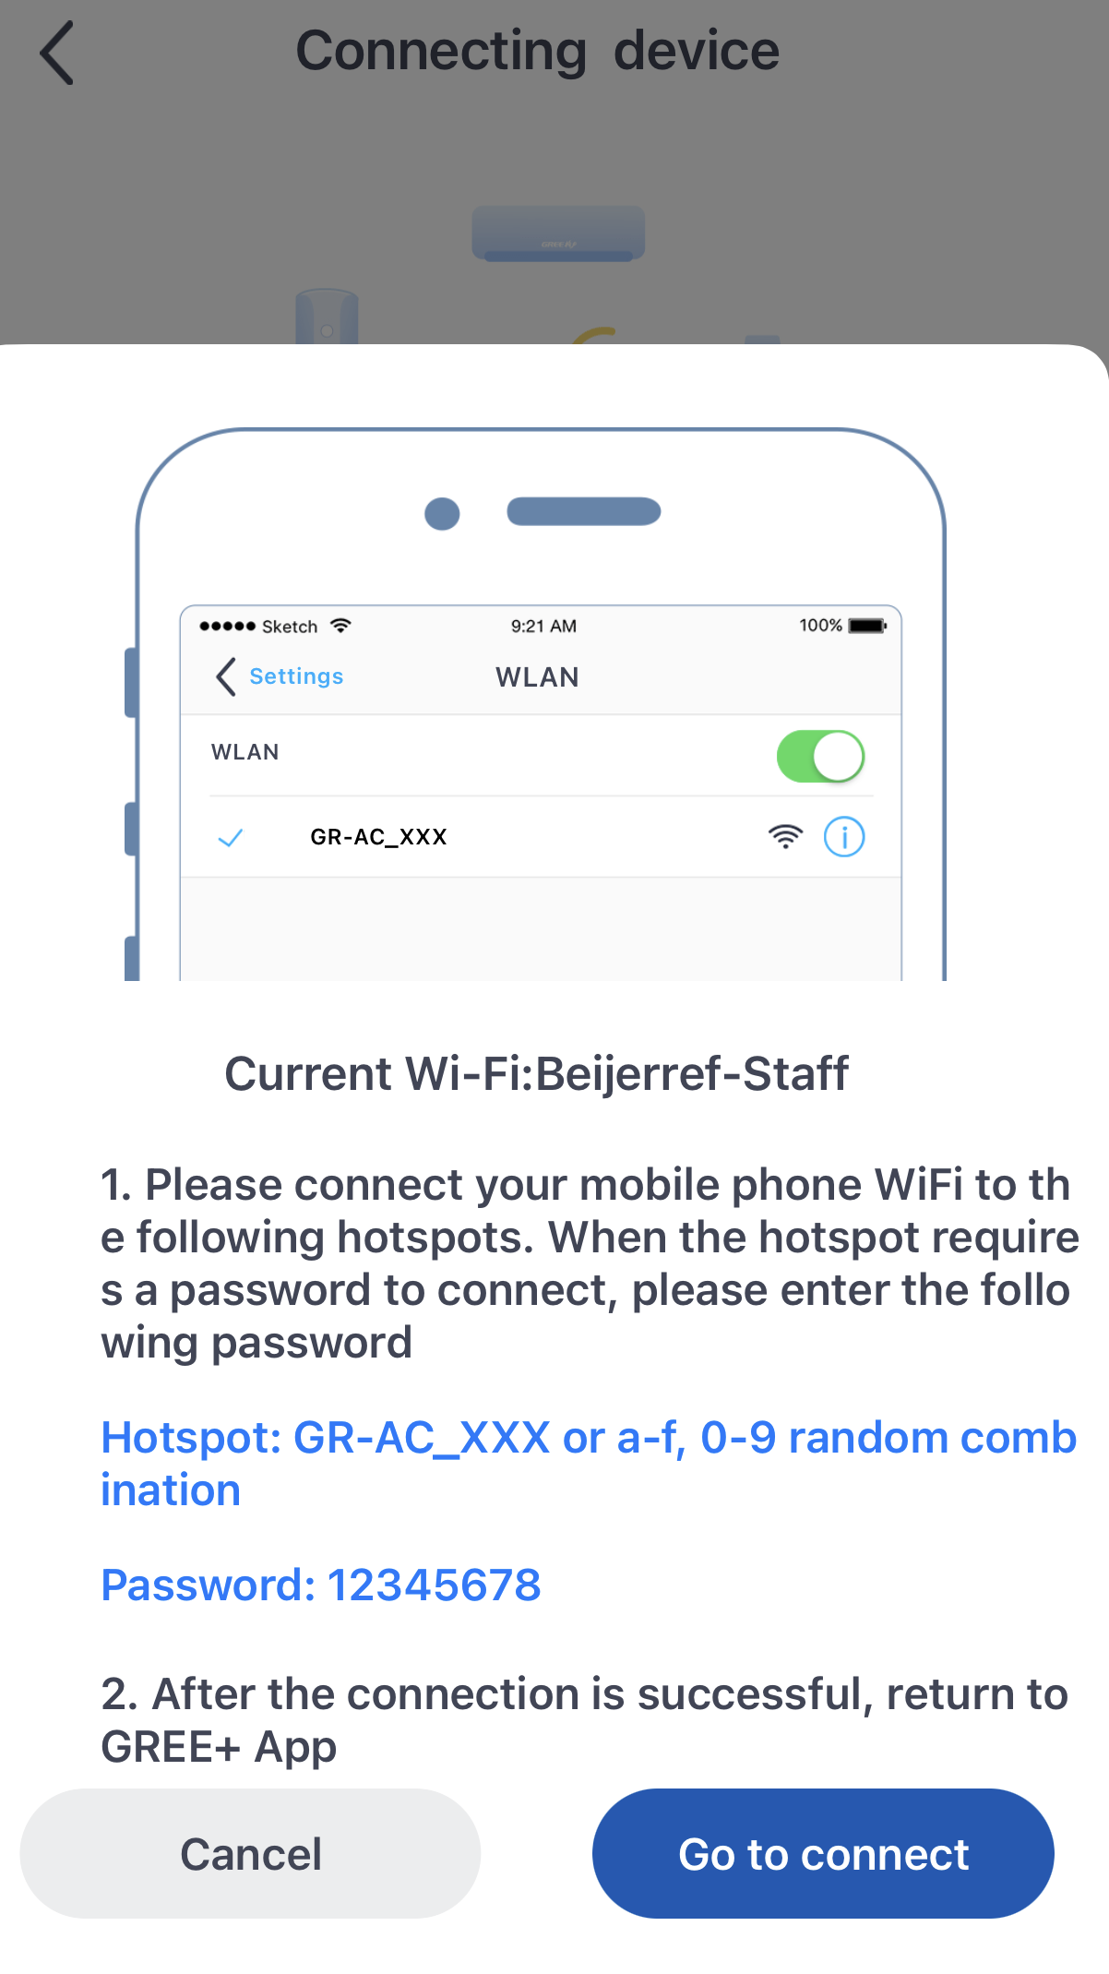
If it fails to connect a fail screen will come up and you can try again but it gives another option. Click the ‘Go to connect’

Slide 9
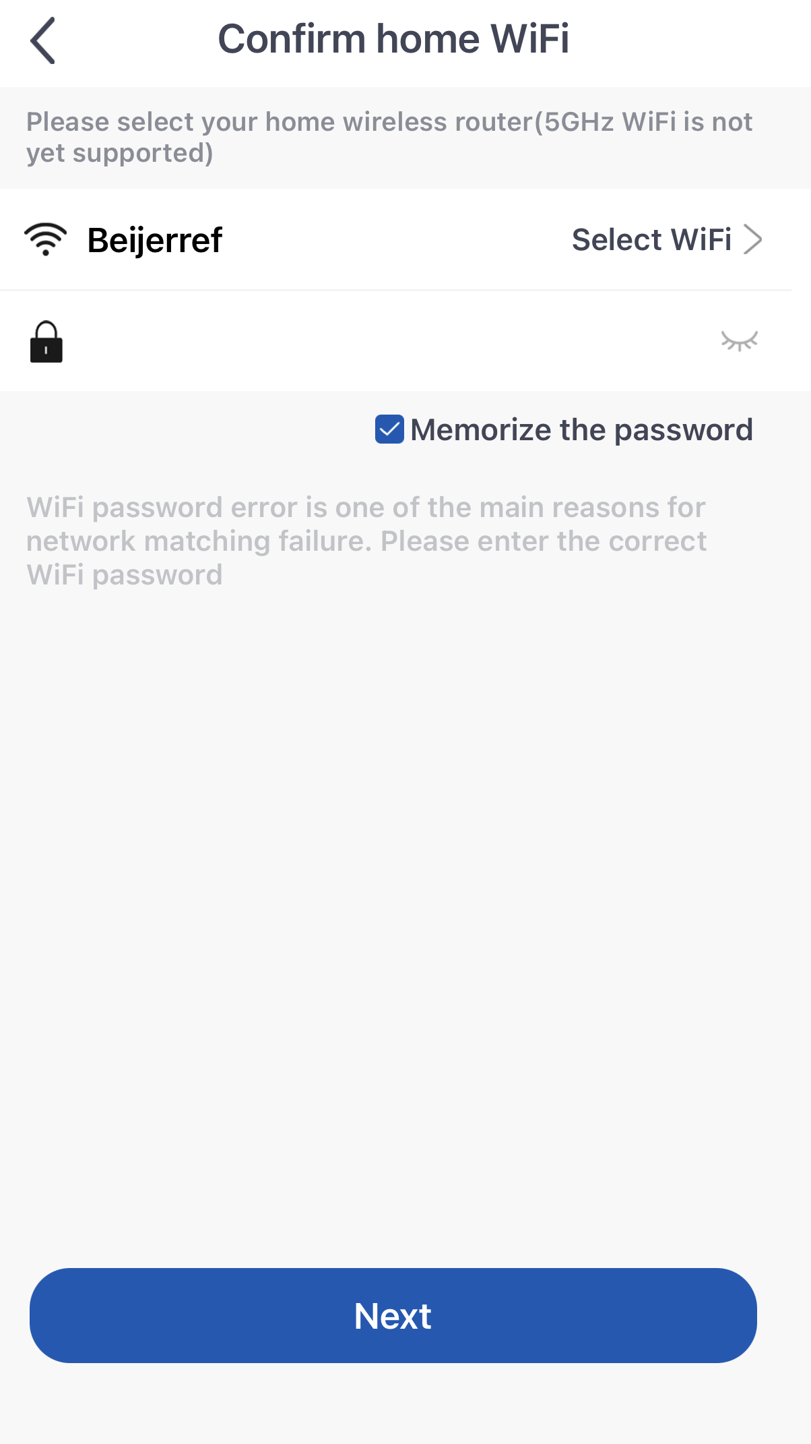
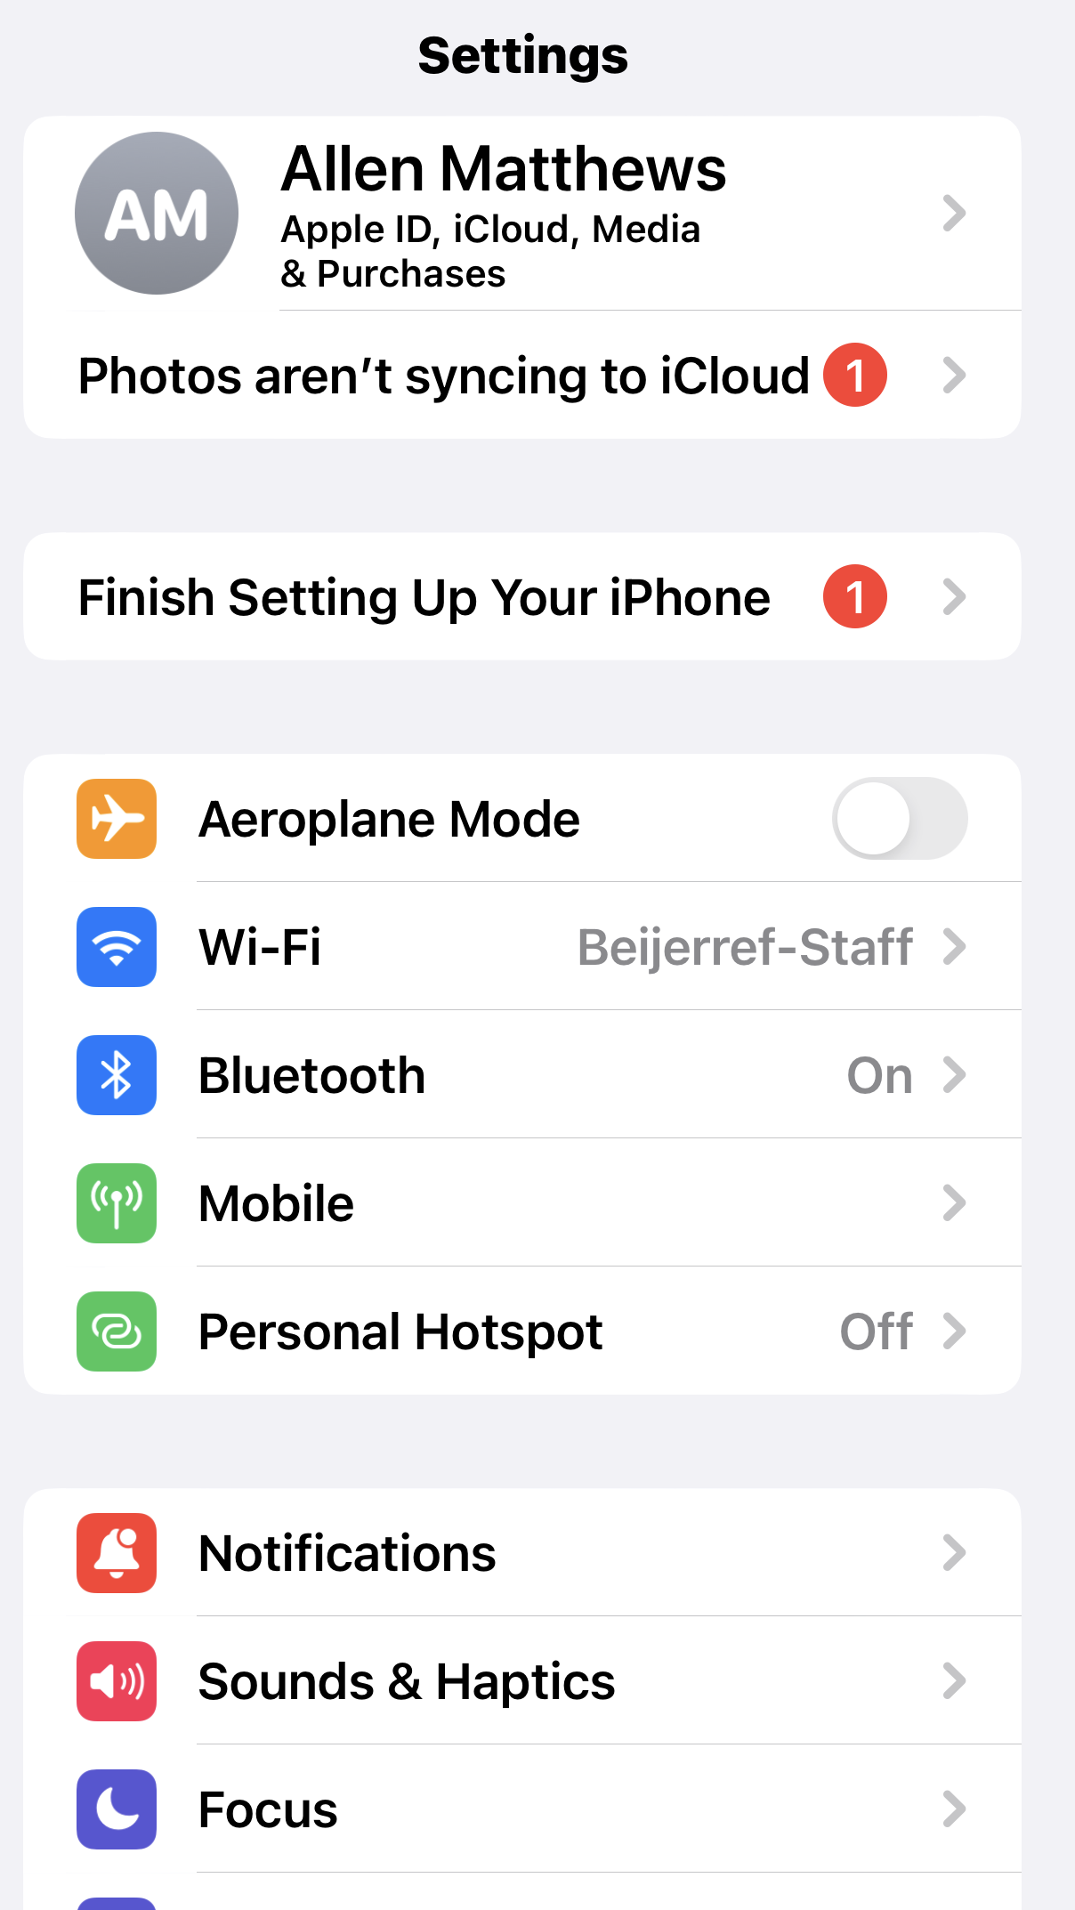
Confirm your Wi-Fi
Click on Wi-Fi on your device

Slide 10
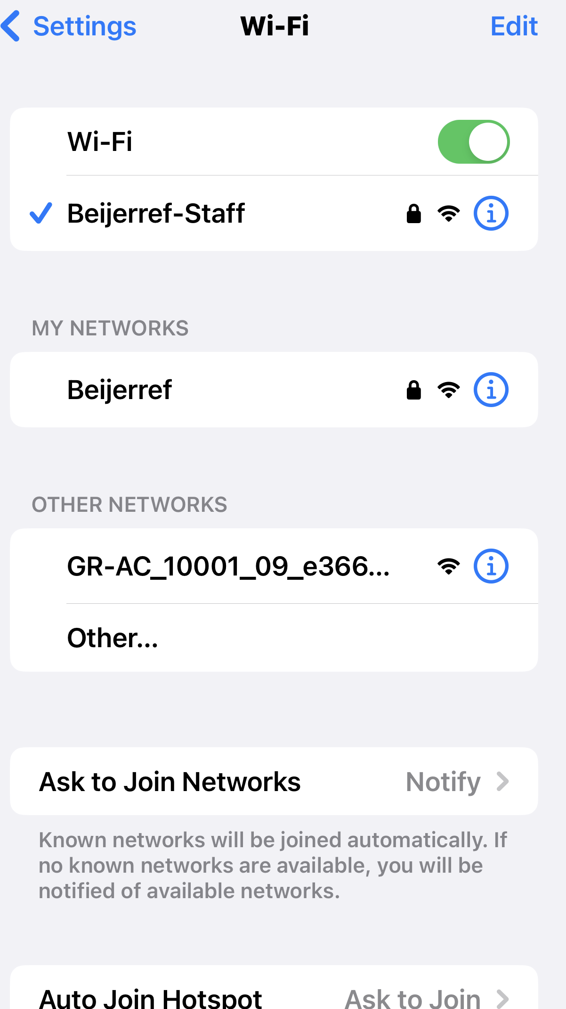
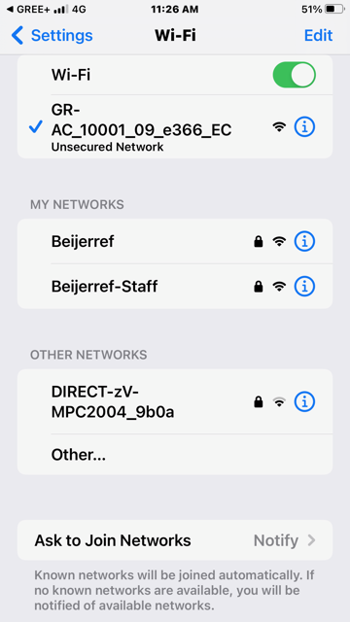
You should see a module come up in other networks
If you click on the module, GR-AC… it will go to Wi-Fi up the top

Slide 11
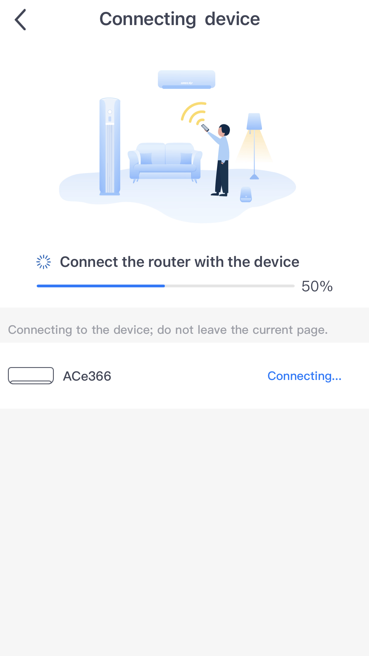
The App should start a search again
Your device should now connect

Slide 12
Click on head symbol to complete connection steps

Slide 13
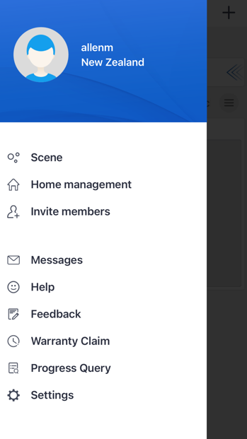
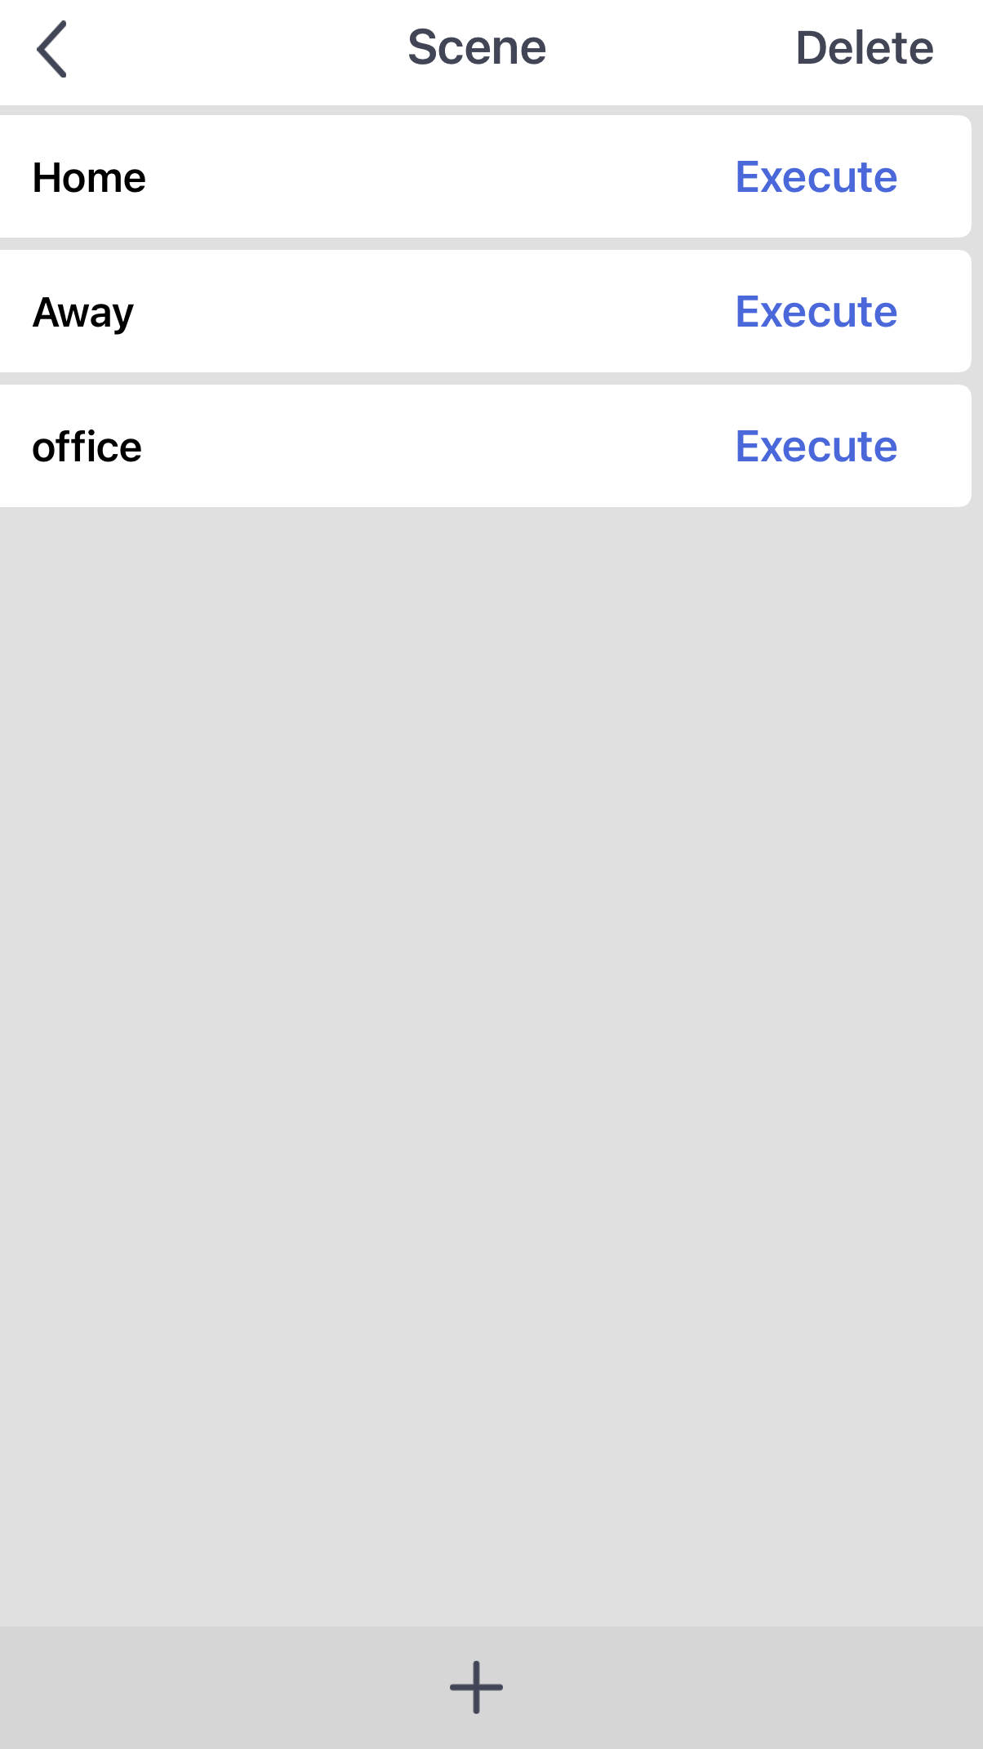
To control the unit from home or while out we need to complete these final stages
Click on Scene and then on to Execute on the Home screen

Slide 14
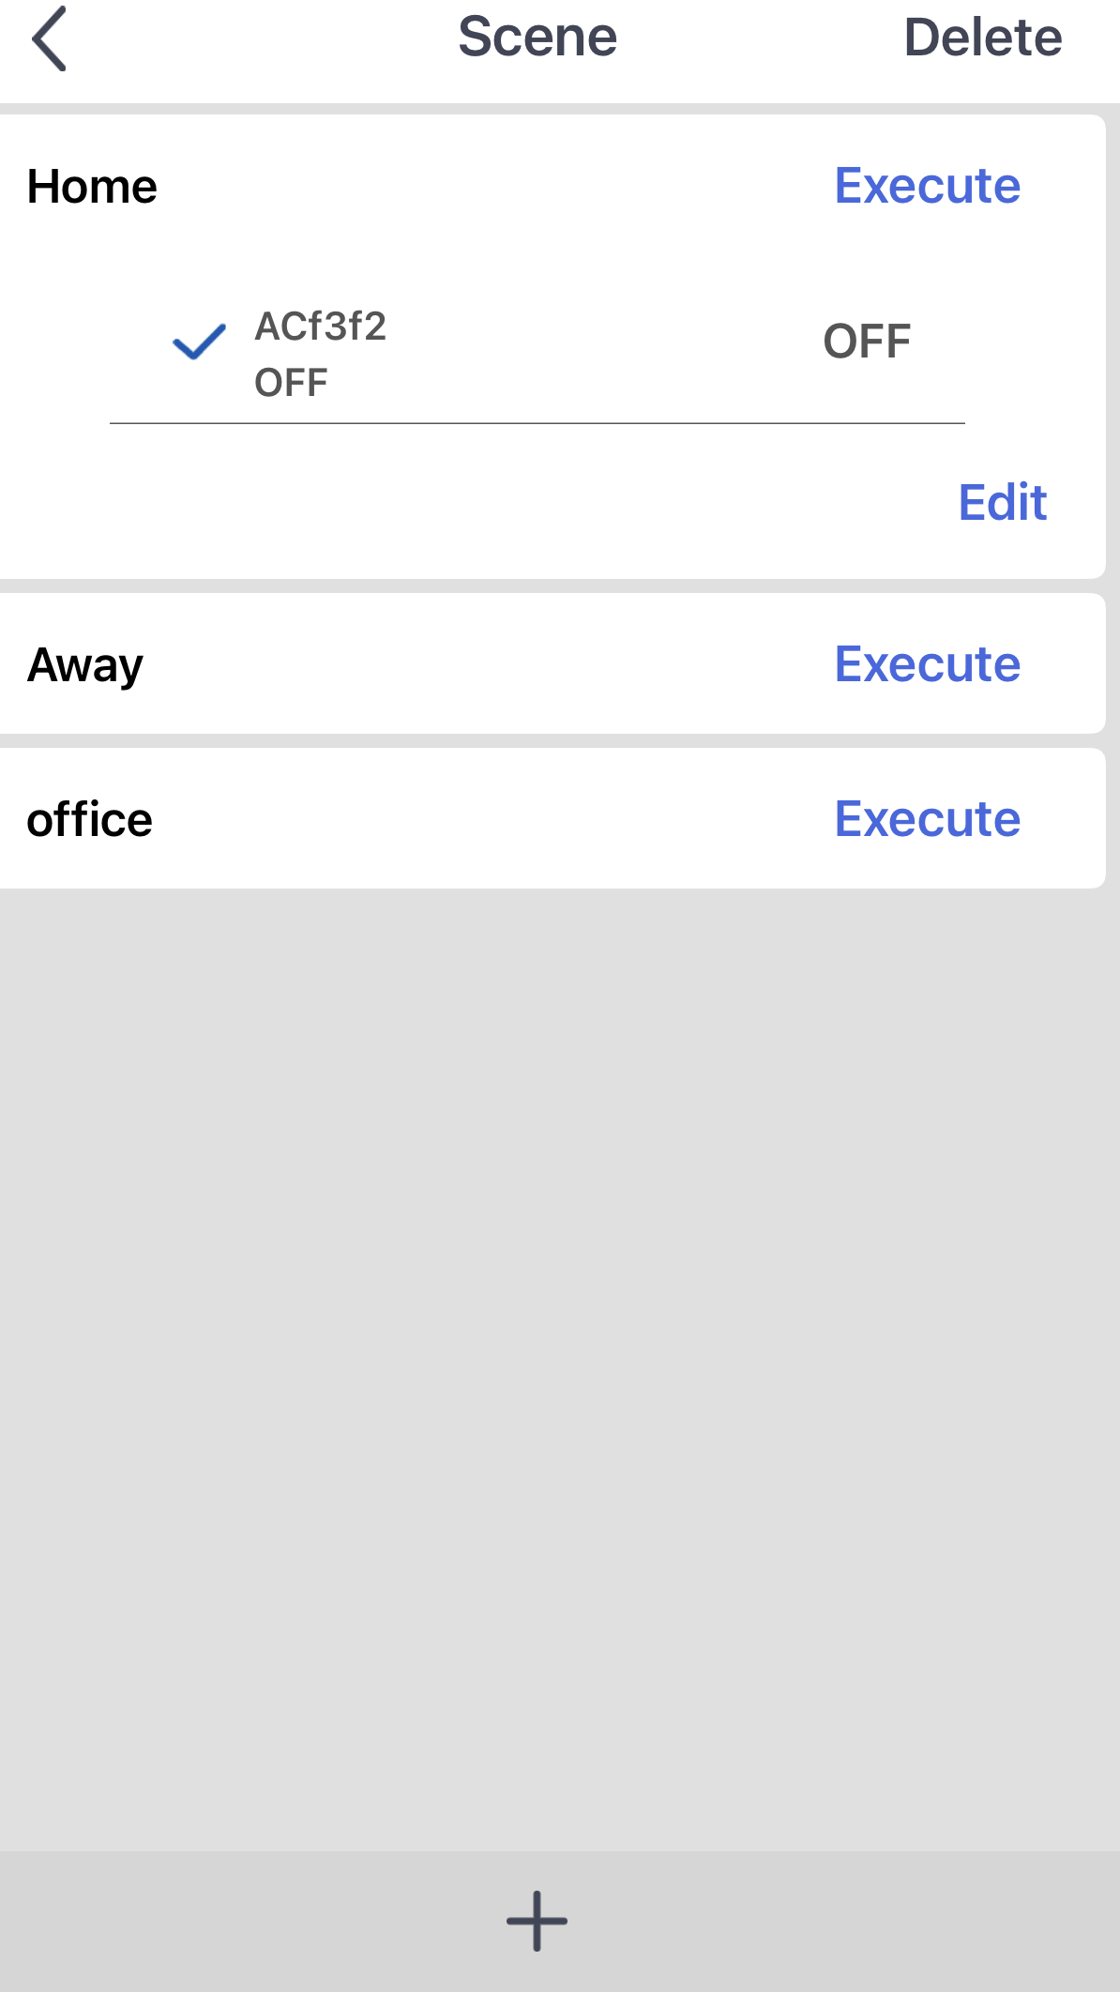
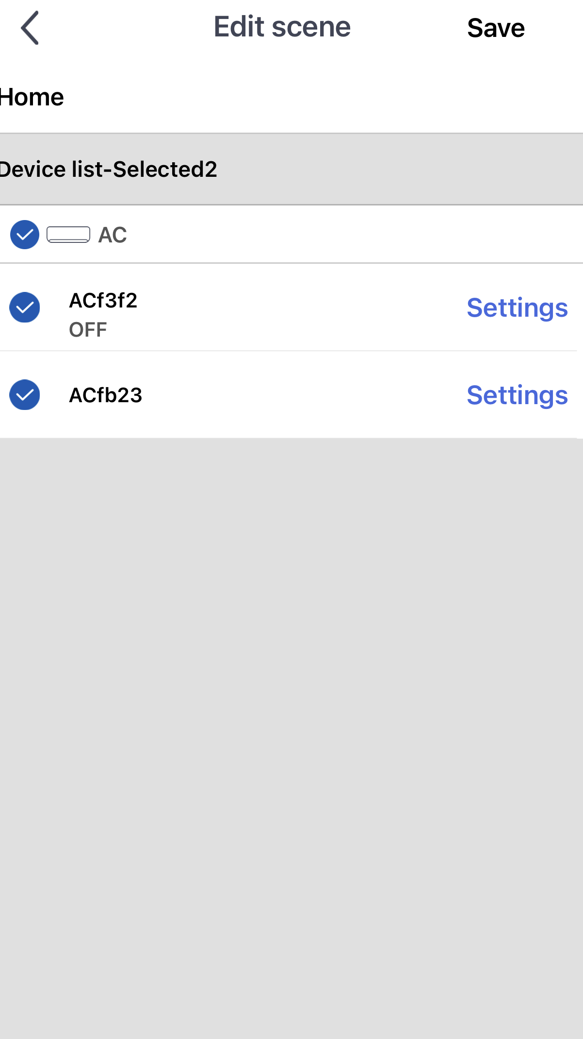
Click Edit and then highlight AC or the unit you want to control and then Save

Slide 15
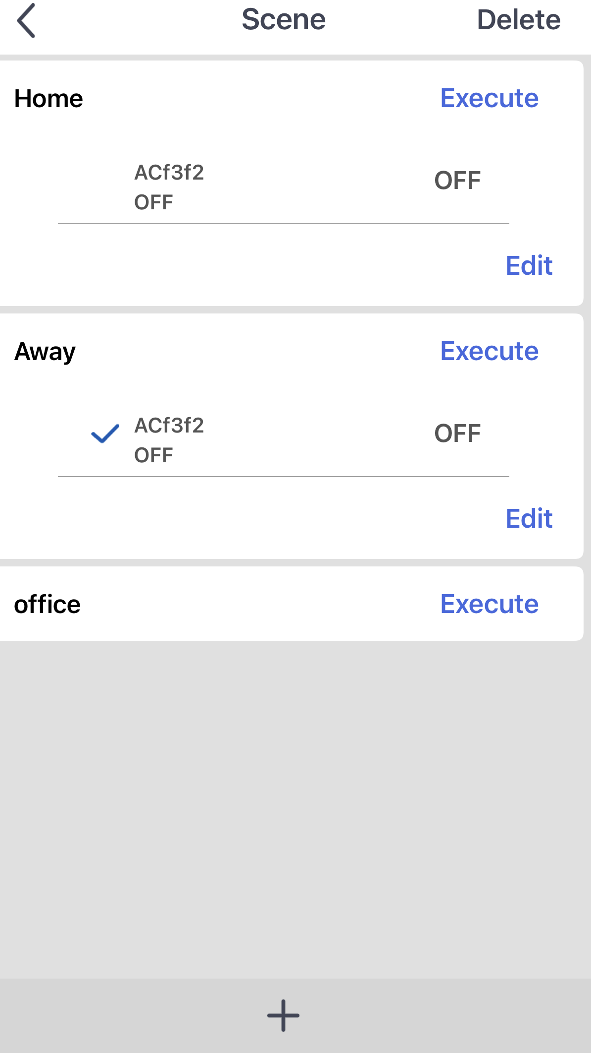
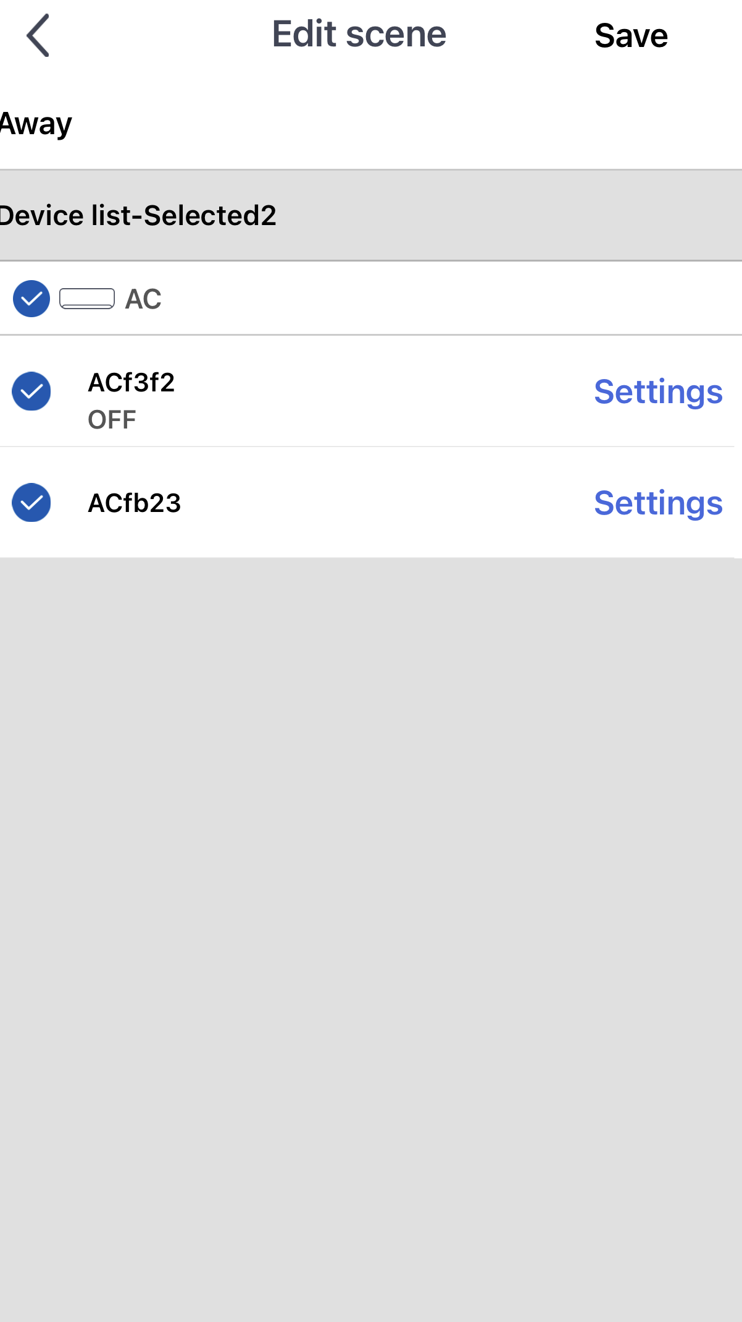
Do the same with Away to allow you to control when you are away from your home Wi-Fi

Slide 16
You can click on the unit you have to bring up the full screen to control it

Slide 17
Also when clicking the head symbol there are several other menus you can go into

Slide 18
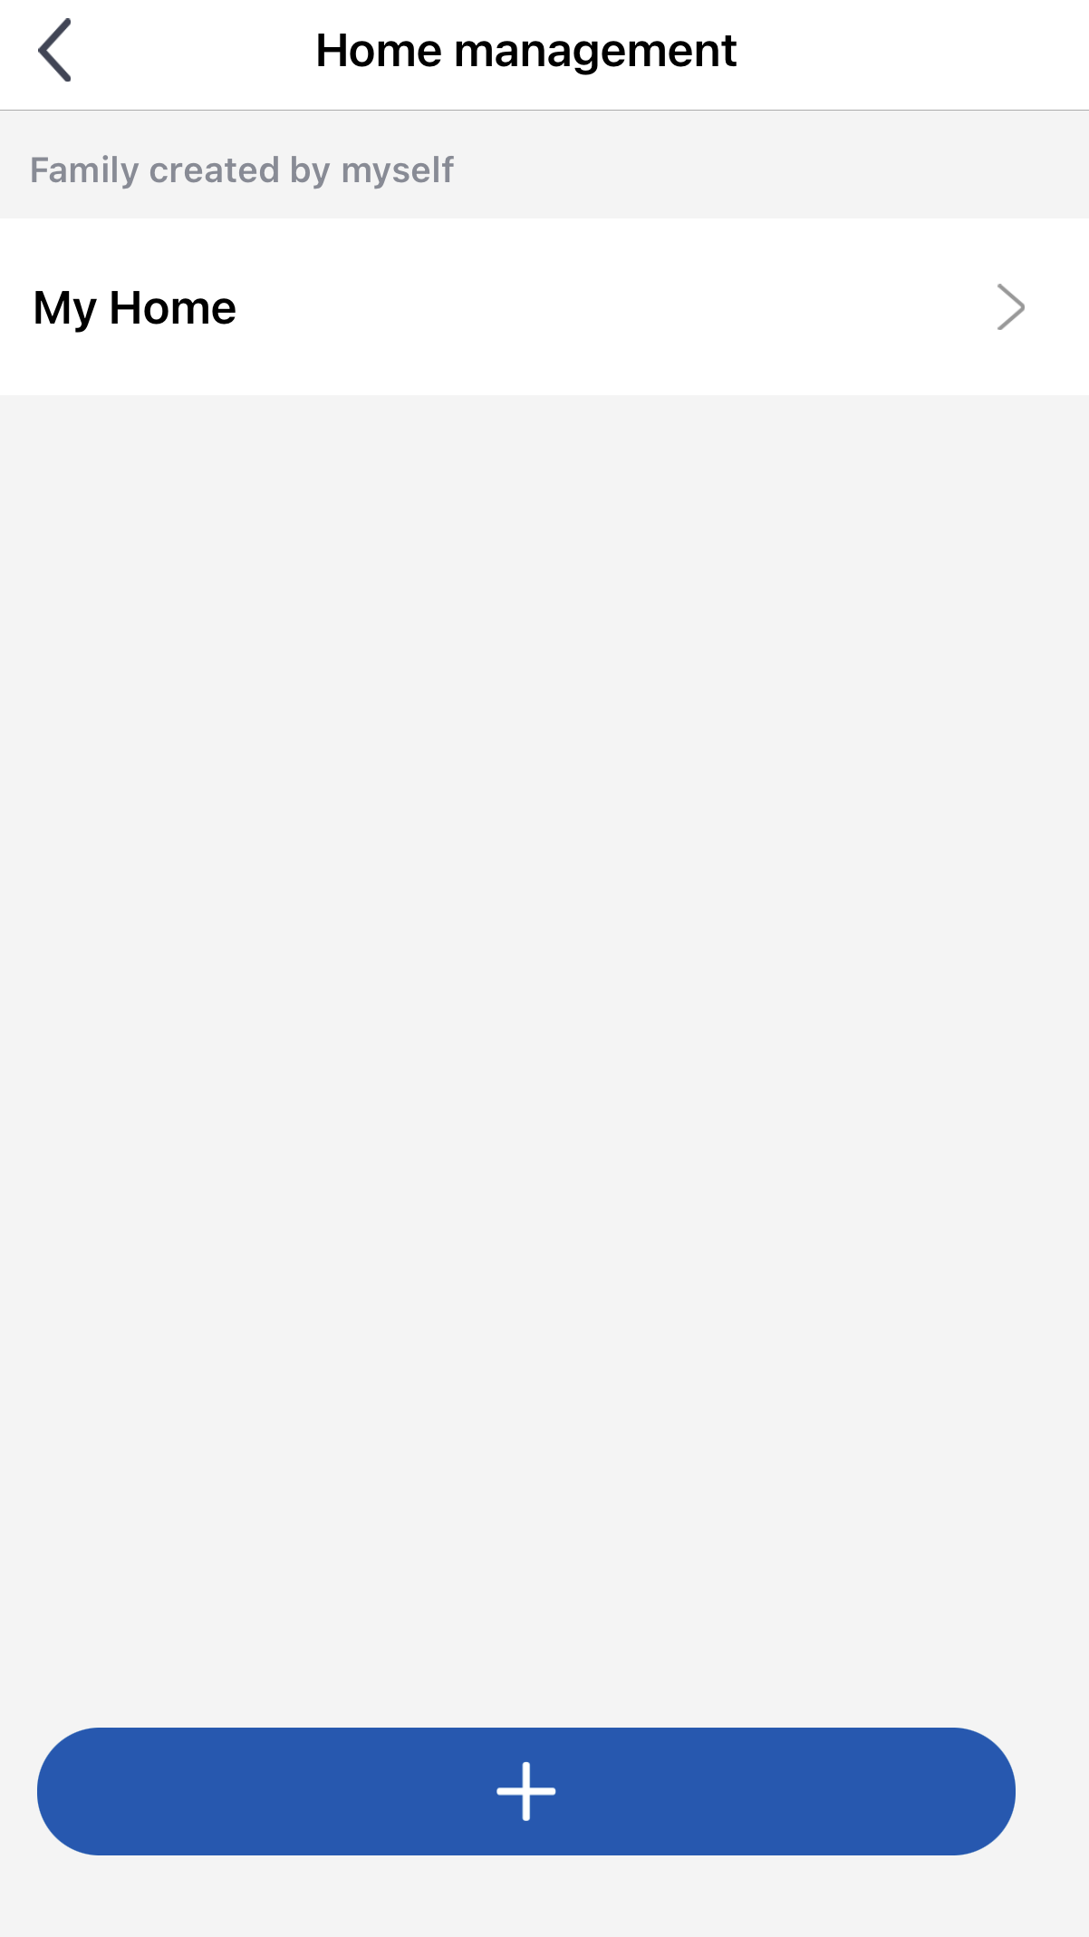
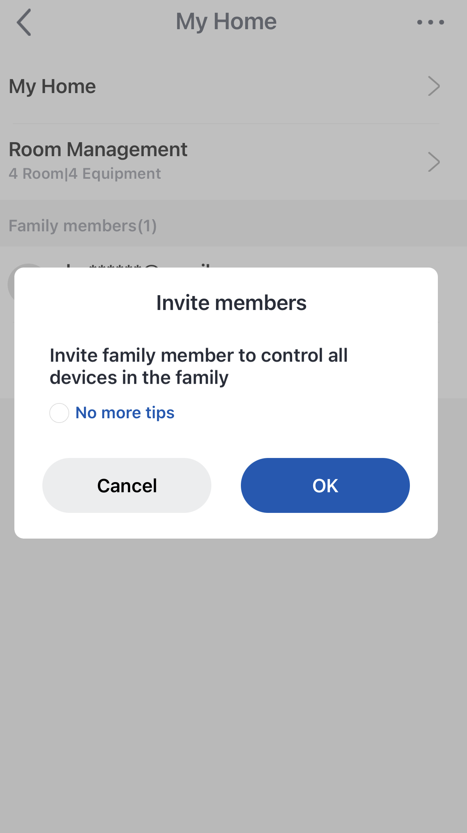
Home management shows units you have connected and has the ability to invite members into the group to control these units

Slide 19
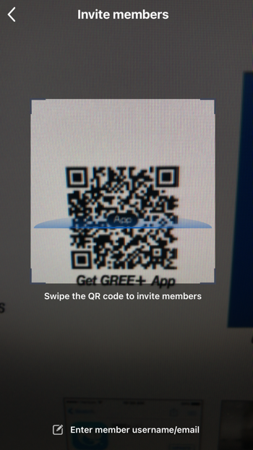
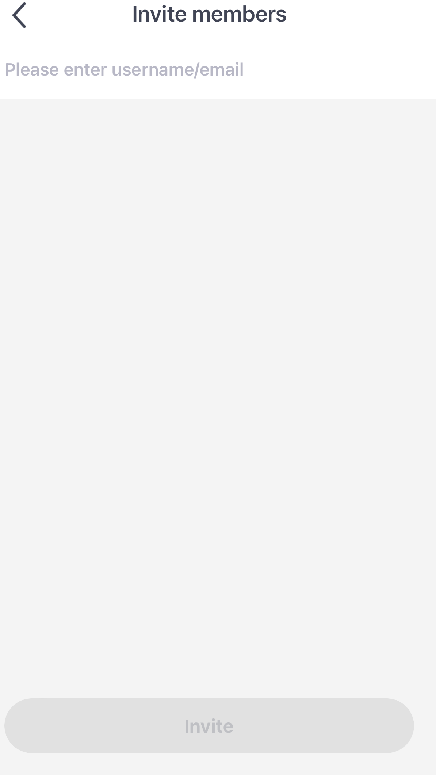
Invite members also gives you the option of inviting someone else to control the unit. This can be done with QR code or email

Slide 20
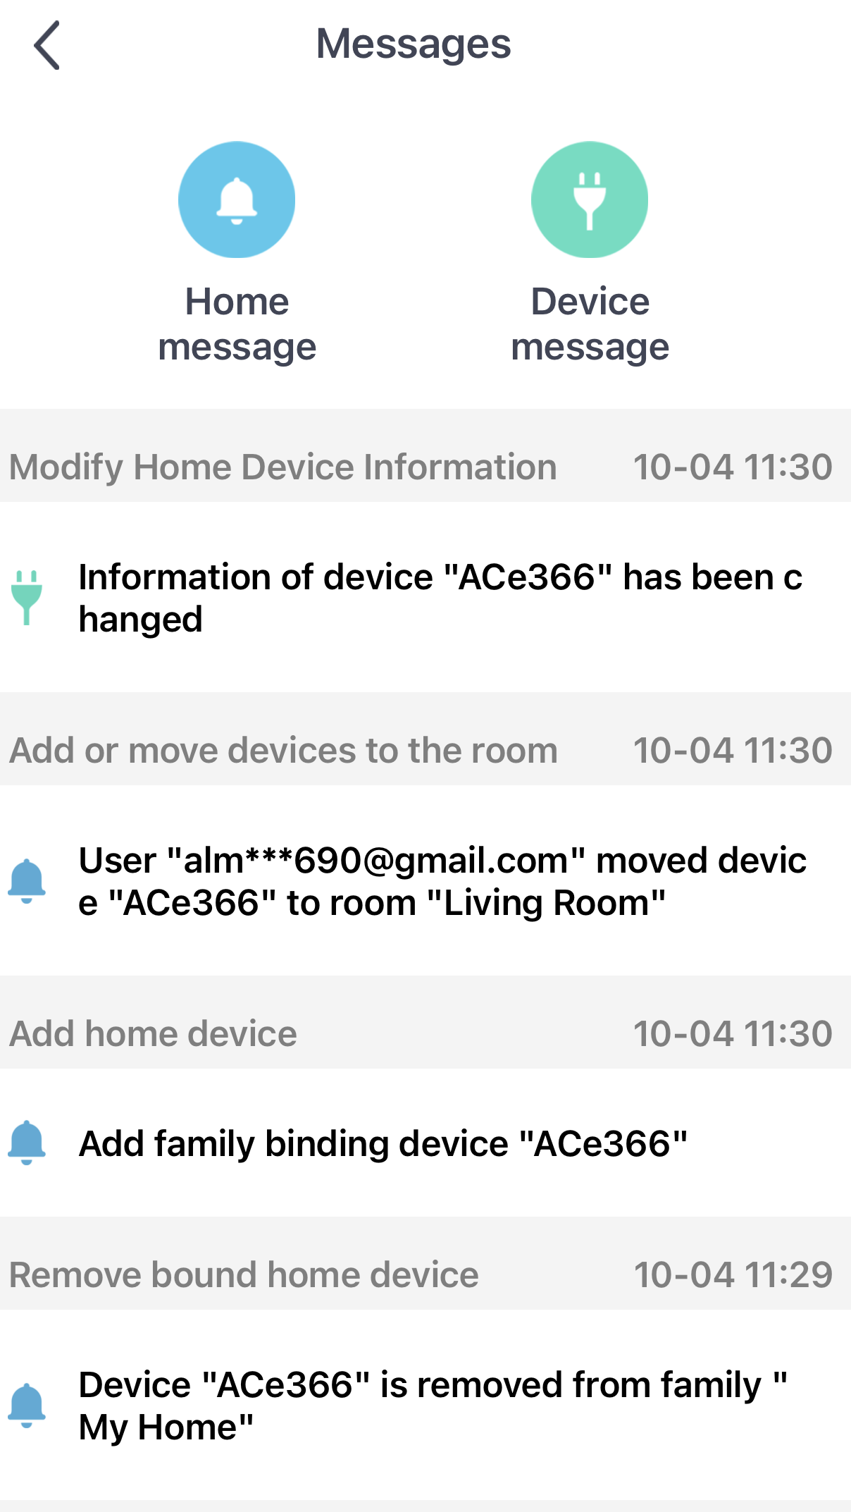
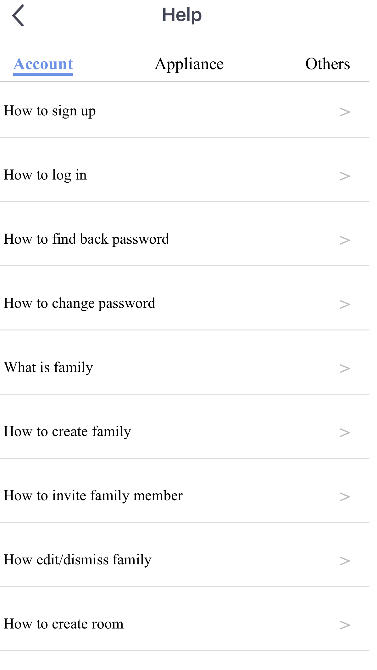
Messages shows you any changes you have made in the App
Help has a drop down list to help make connection and editing easier

Slide 21
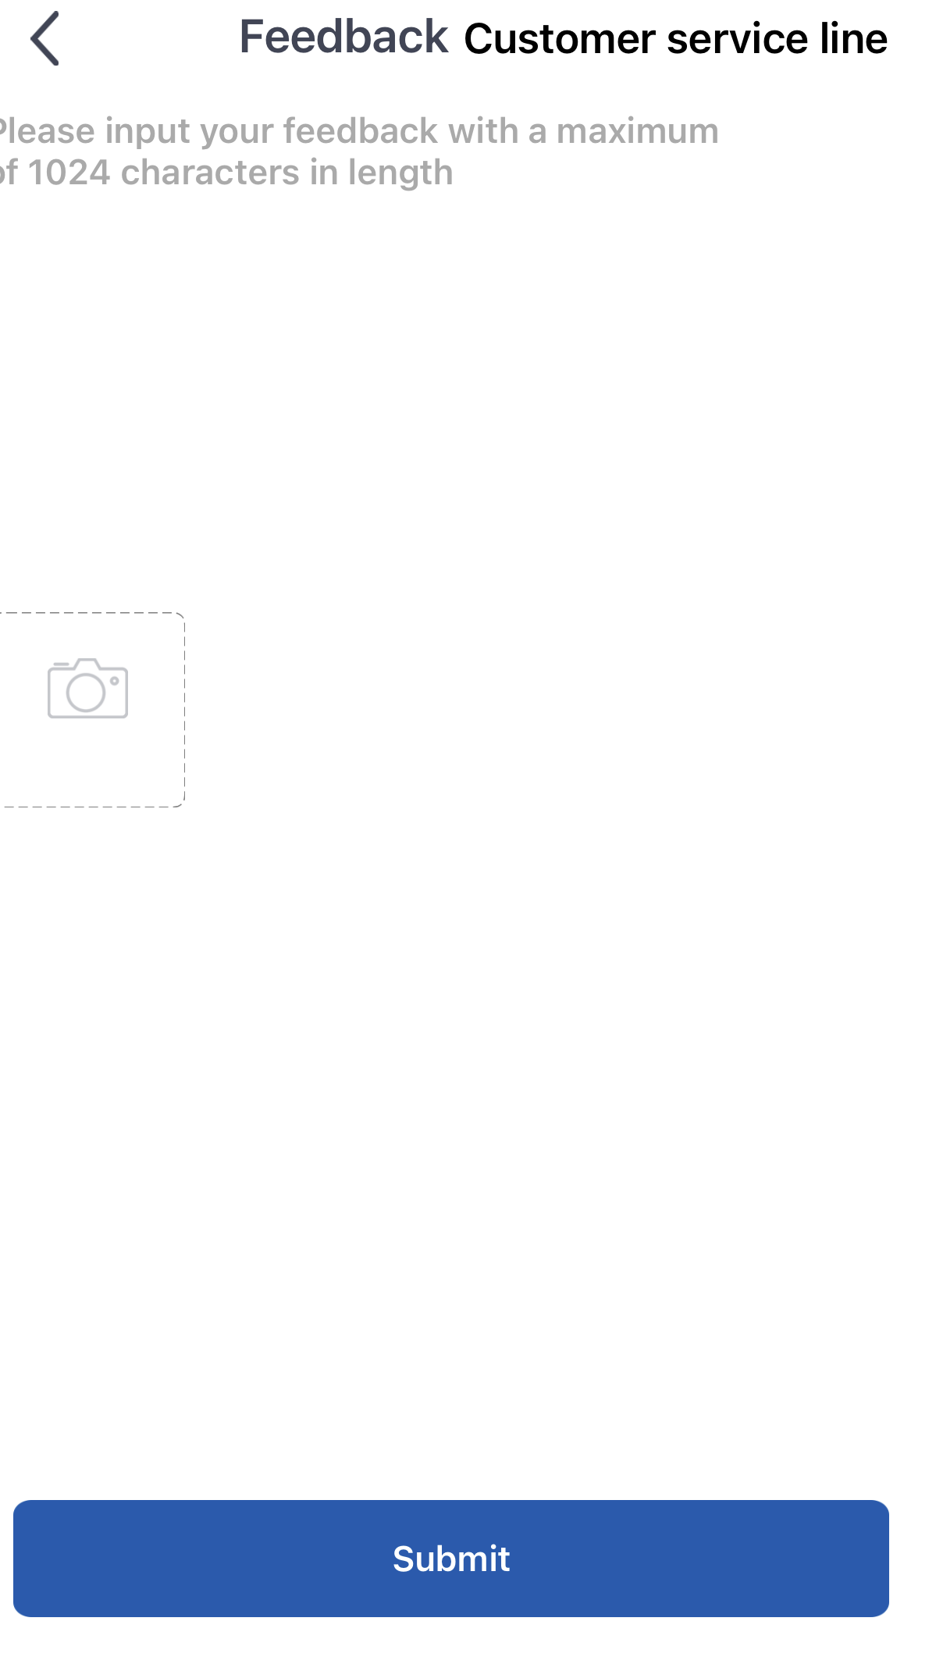
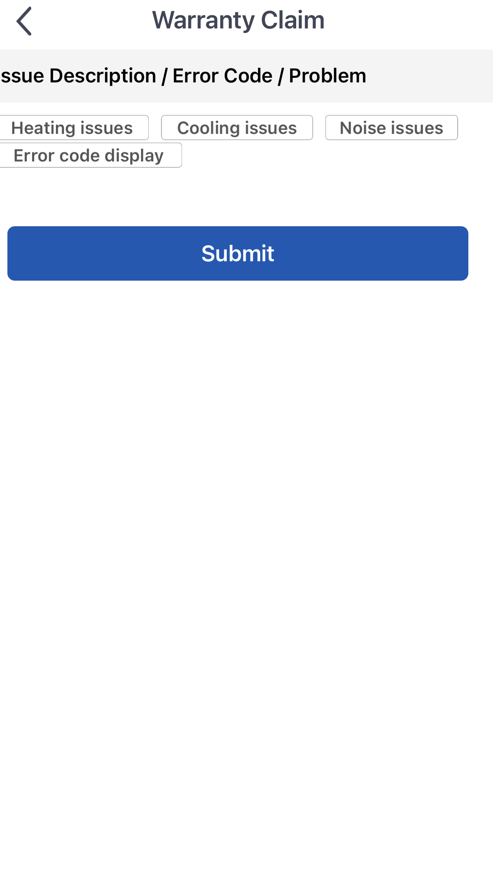
You can feedback information to the Gree factory regarding the App and they can respond
You can advise the Gree factory of problems with your heat pump, and they can respond to this. You would have included your email in registration

Slide 22
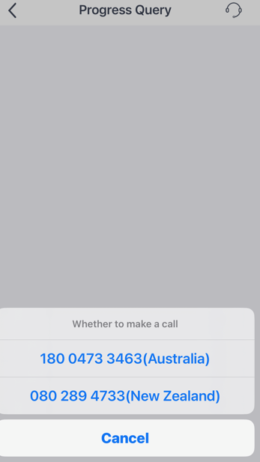
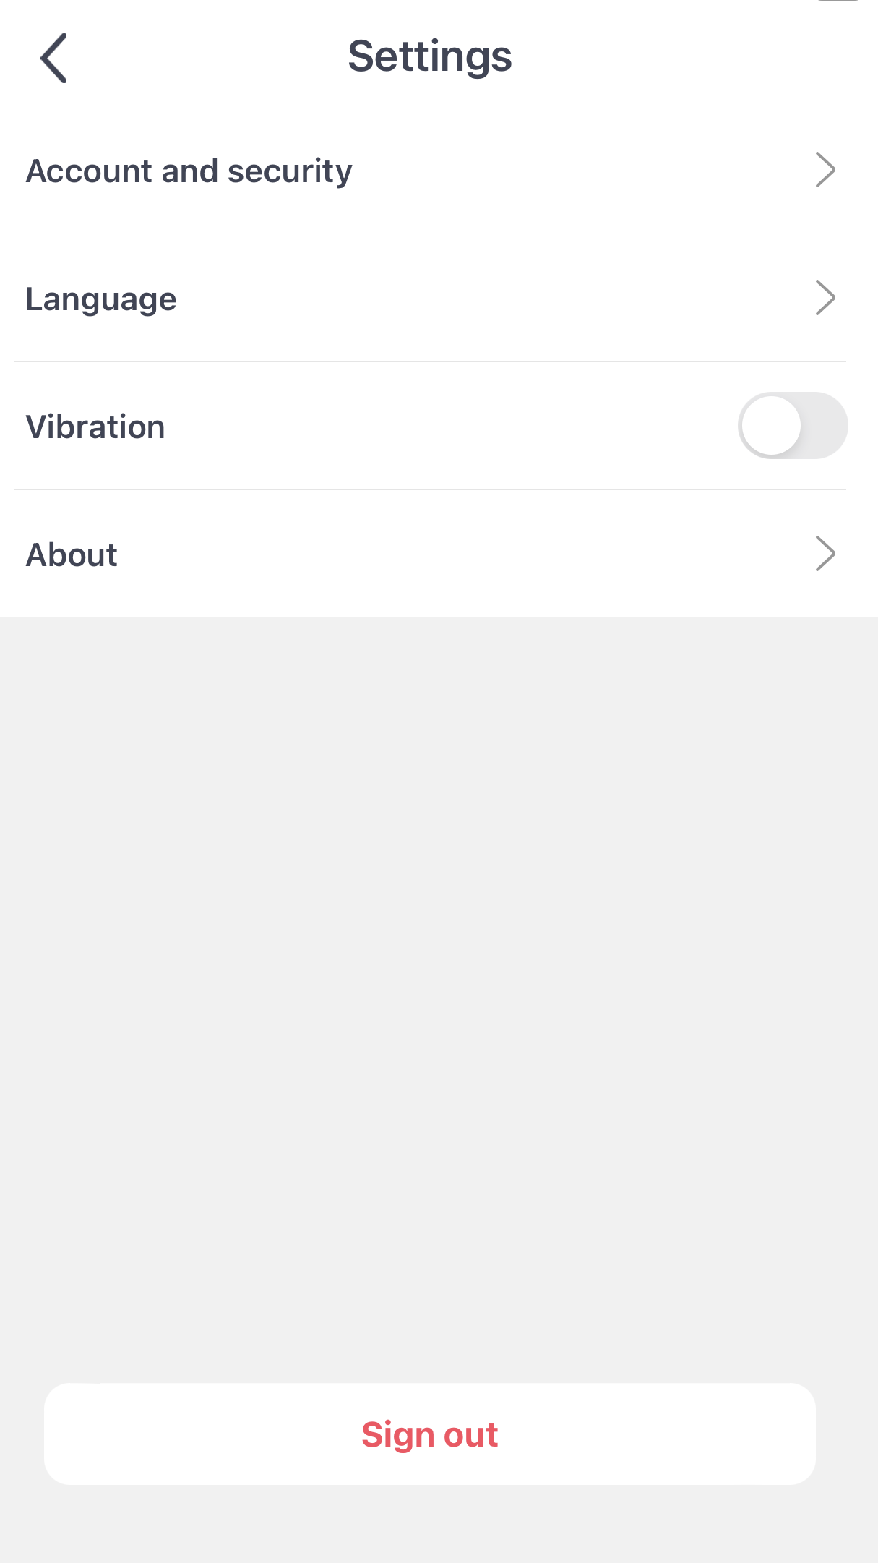
Progress Query gives you the Aust and NZ numbers to call to help with issues on the App
Settings gives you access to change your password, change language, cancel your account,rate the App, show you the version you have, give you the privacy policy

Slide 23
Contact Gree AU
1800 473 346 greeac.com.au

